Slide 1
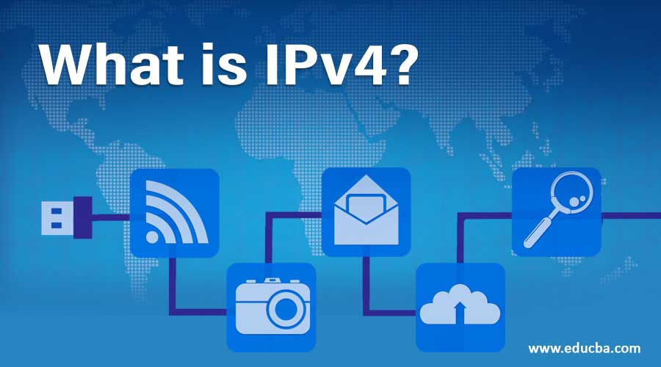
Introduction to IPv4 and Subnetting

Slide 2
What is IP (Internet Protocol) Version 4
Internet Protocol version 4 (IPv4) is the fourth version of the Internet Protocol (IP). It is one of the core protocols of standards-based internetworking methods in the Internet and other packet-switched networks. IPv4 was the first version deployed for production on SATNET in 1982 and on the ARPANET in January 1983. It is still used to route most Internet traffic today, even with the ongoing deployment of Internet Protocol version 6

Slide 3
IPv4 Explained
IP uses Packets to carry information. Every IP packet is a single unit of information and besides data it carries information to determine where to send the packet. IP determines where to send packets to by looking at the destination IP address
We need an IP address to uniquely identify each network device on the network. An IP address is just like a phone number (I’m talking about regular phone numbers, no cellphones). Everyone in a city who has a phone at home has a unique phone number where you can reach them.

Slide 4
IPv4 Explained
Characteristics of IPv4:
Operates at the network layer of the OSI model.
Connectionless protocol: IP itself does not setup a connection, in order to transport data you need the “transport” layer and use TCP or UDP.
Every packet is treated independently; there is no order in which the packets are arriving at their destination.
Hierarchical: IP addresses have a hierarchy; we‟ll discuss this a bit more in depth when we talk about subnetting and subnet masks.

Slide 5
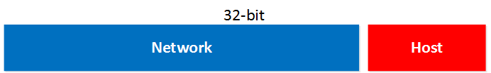
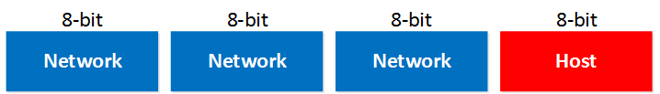
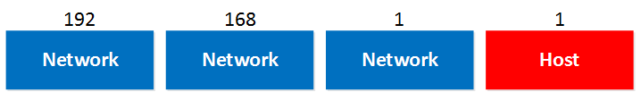
Breaking it down
An IP address is 32-bit and consists of 2 parts, the network part and the host part:
The network part will tell us to which “network” the IP address will belong, you can compare this to the city or area code of a phone number. The “host” part uniquely identifies the network device; these are like the last digits of your phone number.
You probably have seen the IP address 192.168.1.1 before. It’s a very commonly used IP address on local networks. For this IP address the first 3 bytes are the “network” address and the last byte is the “host” address.

Slide 6
Why is that?
Why are the first 3 bytes the “network” part and why is the last byte the “host” part?
If you configure an IP address you also have to specify the subnet mask. Our IP address 192.168.1.1 would come along with the subnet mask 255.255.255.0.
The subnet mask tells your computer which part is the “network” part and which part is the “host” part.

Slide 7
Converting to decimal (192.168.1.1)
What do we know about this IP address? First of all we know it’s a 32-bit value, so in binary it will look like this
IPv4 address in binary 1100000010101000000000001000000001
Now this is a number that is not very human-friendly so to make our life easier we can at least put this number into “blocks” of 8 bits. 8 bits is also called a byte or an octet:
11000000 10101000 000000001 000000001
Now we can convert each byte into decimal
Bits 128 64 32 16 8 4 2 1
0 0 0 0 0 0 0 0
Bits 128 64 32 16 8 4 2 1
1 1 0 0 0 0 0 0
128 + 64 = 192
Continues this method with each byte to convert into decimals

Slide 8
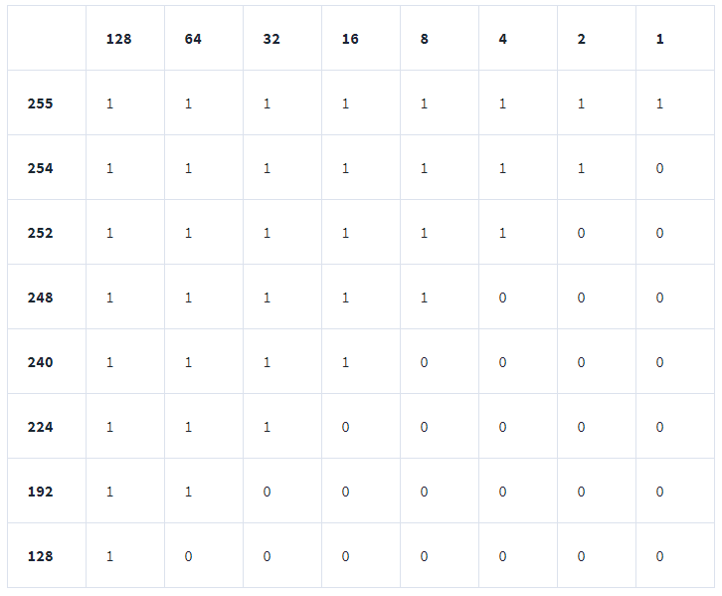
When all the positions are "turned on," they add up to 255.
You can see how it works here. These are the most common octets you'll encounter in subnetting:

Slide 9
Network Classes
IP address that we just used (192.168.1.1) is an example of a class C network.
We have 3 different classes to work with:
Class A
Class B
Class C
The difference between them is how many hosts you can fit in each network
If you use a class A network you can have a LOT of hosts in each network that you create.
If you use a class B you can build more networks, but fewer hosts per network.
With class C you can build a LOT of networks but only with a few hosts in each network.

Slide 10
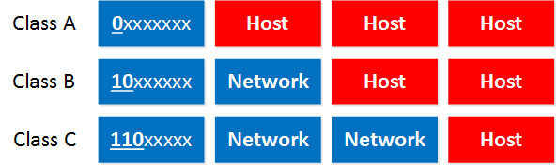
Network Classes Cont.
The last thing I need to tell you about classes is the difference between “private” and “public” IP addresses.
Public IP addresses are used on the Internet.
Private IP addresses are used on your local area network and should not be used on the Internet.
These are the Private IP address ranges:
Class A: 10.0.0.0 – 10.255.255.255
Class B: 172.16.0.0 – 172.31.255.255
Class C: 192.168.0.0 – 192.168.255.255
Class A: The first bit always has to be 0.
Class B: The first 2 bits always have to be 10.
Class C: The first 3 bits always have to be 110.
So if you calculate this from binary to decimal you’ll get the following ranges:
Class A starts at 0.0.0.0
Class B starts at 128.0.0.0
Class C starts at 192.0.0.0

Slide 11
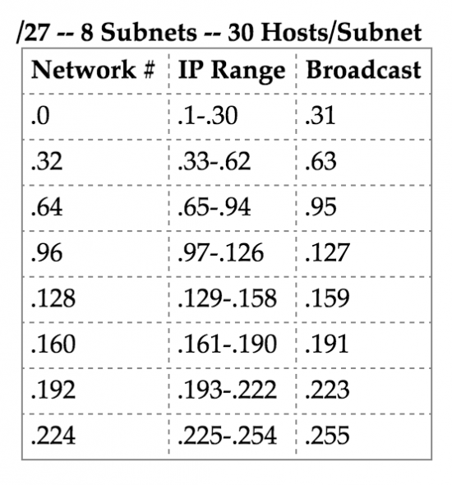
Network and Boradcast
There are 2 IP addresses we cannot use on our network.
Network address.
Broadcast address.
The network address cannot be used on a computer as an IP address because it’s being used to “define” the network.
The broadcast address cannot be used on a computer as an IP address because it’s used by broadcast applications. A broadcast is an IP packet that will be received by all devices in your network.

Slide 12
Example
Class C IP address 192.168.1.1.
We need to look at the last octet which is being used for hosts. If we set all the bits to 0 in our “host” part then we have the network address: 192.168.1.0
So 192.168.1.0 is the network address in this case and we are unable to use this IP address for computers.
If we set all the bits to 1 we’ll have a broadcast IP address and we also cannot use this for computers: 192.168.1.255
So in summary:
Set all the host bits to 0 gives you the network address.
Set all the host bits to 1 gives you the broadcast address.
These 2 IP addresses we cannot use for computers.

Slide 13
What is Subnetting
Subnetting is the process of taking a network and splitting it into smaller networks, known as subnets. It's used to free up more public IPv4 addresses and segment networks for security and easier management.

Slide 14
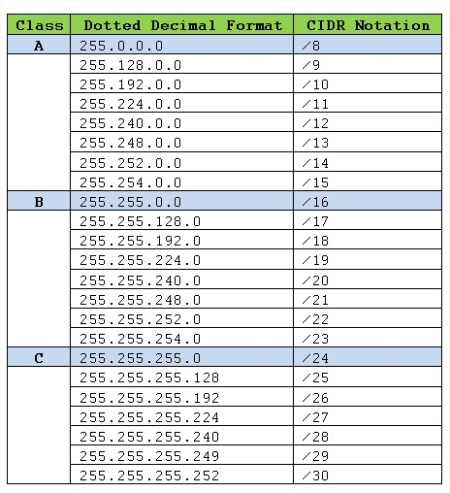
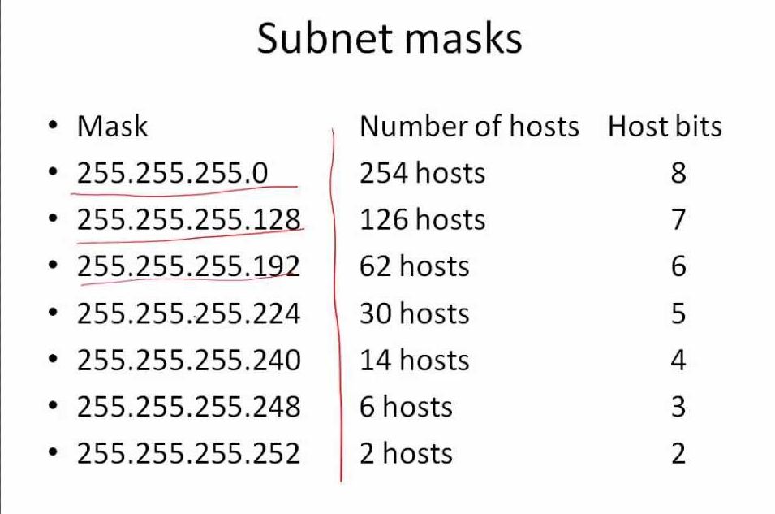
Now that we know about classes, binary, and subnets. Let's dive into a subnet.
192.168.10.128 /27

Slide 15
192.168.10.128 /27
Network: 192.168.10.128
Default gateway: 192.168.10.129
Host: 192.168.10.130 -158
Broadcast: 192.168.10.159
Subnet Mask: 255.255.255.224
Total Number of Hosts: 32
Number of Usable Hosts: 30
Next network 192.168.10.160

Slide 16
Questions?

